Slide 1
Lecture 10c
Network Layer (3): ARP and Routing

Slide 2
Motivation for the Network Layer
How do I deal with the diversity of nets and provide internetworking?
How do I structure packets?
How do I find a host on a local subnet?
How do I get a packet through the network?
IP addresses are globally unique
Need a routing algorithm for finding a path between routers

Slide 3
Internet Routing Protocols
Responsible for receiving and forwarding packets between interconnected networks
Must dynamically adapt to changing network conditions
Two key concepts
Routing information
Routing algorithm

Slide 4
Autonomous Systems (AS)
Key characteristics
Set of routers and networks managed by single organization
group of routers exchanging information via a common routing protocol
connected (in a graph-theoretic sense); that is, there is a path between any pair of nodes
Interior Router Protocol (IRP) passes information between routers within an AS (Intra-AS)
Exterior Router Protocol (ERP) passes information between routers in different AS (Inter-AS)

Slide 5
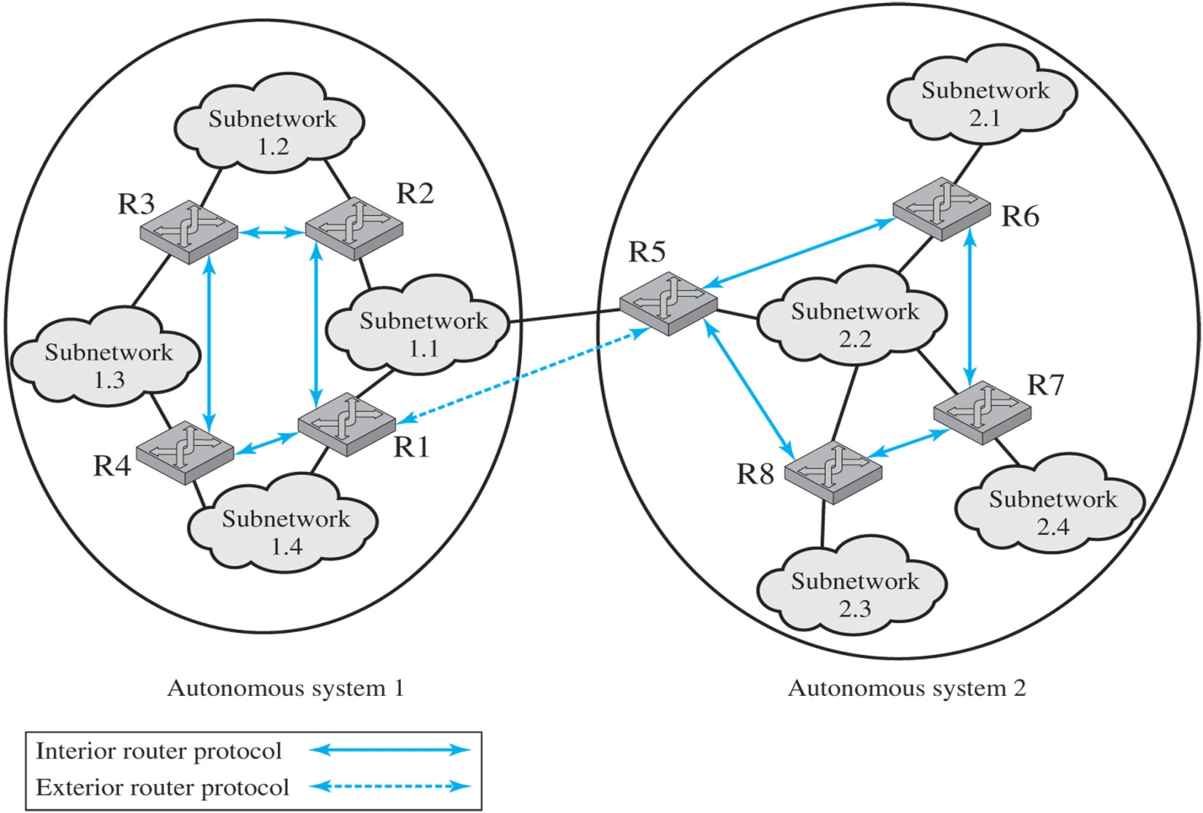
Autonomous System Example

Slide 6
Routing in the Internet
Hierarchical and network specific (instead of host specific) to reduce the size of the routing tables
Routing table maps IP address or subnet address to next router hop
Packet is first delivered to the AS
The AS sends it to the right network
The network sends it to the host

Slide 7
Intra-AS and Inter-AS Routing
C.b
Inter-AS
routing
between
A and B
B.a
A.a
Host
h2
b
c
A.c
a
a
C
b
a
B
Host
h1
d
Intra-AS routing
within AS B
c
A
b
Intra-AS routing
within AS A

Slide 8
Routing Protocols
Used so that routers can exchange routing information
Common routing protocols
RIP: Routing Information Protocol (Interior)
OSPF: Open Shortest Path First (Interior)
BGP: Border Gateway Protocol (Exterior)
These protocols are used to build routing tables
These tables are adaptive, changing as required by the state of the network elements (links and routers)

Slide 9
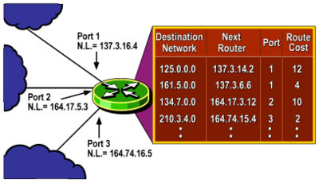
Routing table
Each router maintains table of IP addresses or subnet addresses, next hop router IP address, output interface/port and possibly cost of using route
Table is DYNAMIC – routes and cost change with time!

Slide 10
General Steps for learning routes
1. Each router, independent of the routing protocol, adds a route to its routing table for each subnet directly connected to the router.
2. Each router’s routing protocol tells its neighbors about the routes in its routing table, including the directly connected routes and routes learned from other routers.
3. After learning a new route from a neighbor, the router’s routing protocol adds a route to its IP routing table, with the next-hop router of that route typically being the neighbor from which the route was learned.

Slide 11
Example Traceroute
See Pages 27-29 of textbook
Several tool to view routes – used traceroute
traceroute to www.bart.gov (166.78.65.188), 64 hops max, 72 byte packets
1 192.168.1.1 (192.168.1.1) 1.635 ms 1.178 ms 1.148 ms
2 96.179.236.1 (96.179.236.1) 12.325 ms 8.463 ms 11.068 ms
3 te-0-1-0-7-sur02.pittsburgh.pa.pitt.comcast.net (68.85.234.45) 9.519 ms 8.728 ms 10.133 ms
4 te-0-8-0-13-ar03.mckeesport.pa.pitt.comcast.net (68.86.146.65) 12.026 ms
te-0-8-0-0-ar03.mckeesport.pa.pitt.comcast.net (69.139.194.5) 10.929 ms 19.690 ms
5 he-4-5-0-0-cr01.ashburn.va.ibone.comcast.net (68.86.94.165) 16.728 ms 19.267 ms 19.620 ms
6 he-0-10-0-0-cr01.newyork.ny.ibone.comcast.net (68.86.85.10) 23.093 ms 19.897 ms 19.817 ms
7 he-0-7-0-0-cr01.350ecermak.il.ibone.comcast.net (68.86.88.158) 40.318 ms 41.288 ms 43.698 ms
8 he-0-10-0-0-pe04.350ecermak.il.ibone.comcast.net (68.86.83.50) 39.720 ms 39.781 ms 41.588 ms
9 23-30-206-226-static.hfc.comcastbusiness.net (23.30.206.226) 40.045 ms 40.281 ms 39.701 ms
10 coreb.ord1.rackspace.net (184.106.126.146) 39.532 ms 41.685 ms 40.601 ms
11 coreb-core5.ord1.rackspace.net (50.56.6.131) 42.286 ms 43.311 ms 41.399 ms
12 core5-aggr1101a-3.ord1.rackspace.net (50.56.6.217) 40.039 ms 42.739 ms 41.407 ms
13 166.78.65.188 (166.78.65.188) 41.182 ms 40.840 ms 44.217 ms

Slide 12
Border Gateway Protocol
Exterior protocol
“Path vector” algorithm
Finds a path through the collection of autonomous systems
Neighbor acquisition
Neighbor reachability
Network reachability
Assumes the existence of an interior protocol in each AS
Reachability information is shared with neighboring AS’s
Example: http://bgplay.routeviews.org/

Slide 13
Autonomous System Example

Slide 14
Neighbor Acquisition
Neighbors are two routers that share the same network across an AS border
Acquisition occurs when the acquisition procedure results in the two routers agreeing to share routing information
Acquisition procedure
One router sends Open
Other returns Keepalive if it accepts the request

Slide 15
Reachability
Neighbor
Needed to maintain acquired relationships
Procedure: both routers periodically send Keepalive messages to each other
Network
Each router maintains a database of
Networks it can reach
Preferred route for reaching each network
When this changes, an Update is sent to the neighbor(s)
This propagates the reachability information through the network

Slide 16
Open Shortest Path First (OSPF)
Interior AS router protocol (usually)
“Link state” algorithm
Approach
Each router maintains descriptions of the state of the attached links
Periodically broadcasts updated state information to all routers it knows about
OSPF computes routes that minimize “cost”
Distributed algorithm
Each router maintains a database of the known topology

Slide 17
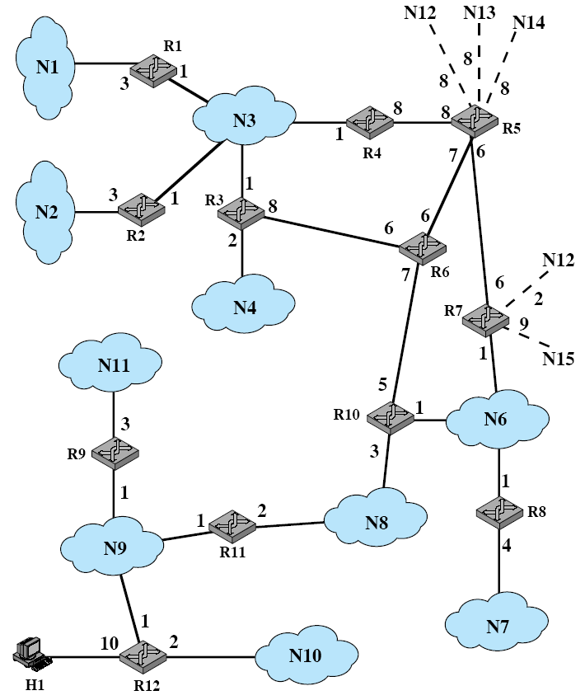
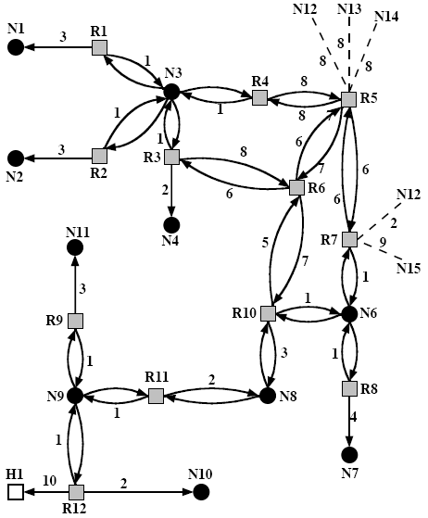
OSPF
Autonomous System
Directed Graph of AS

Slide 18
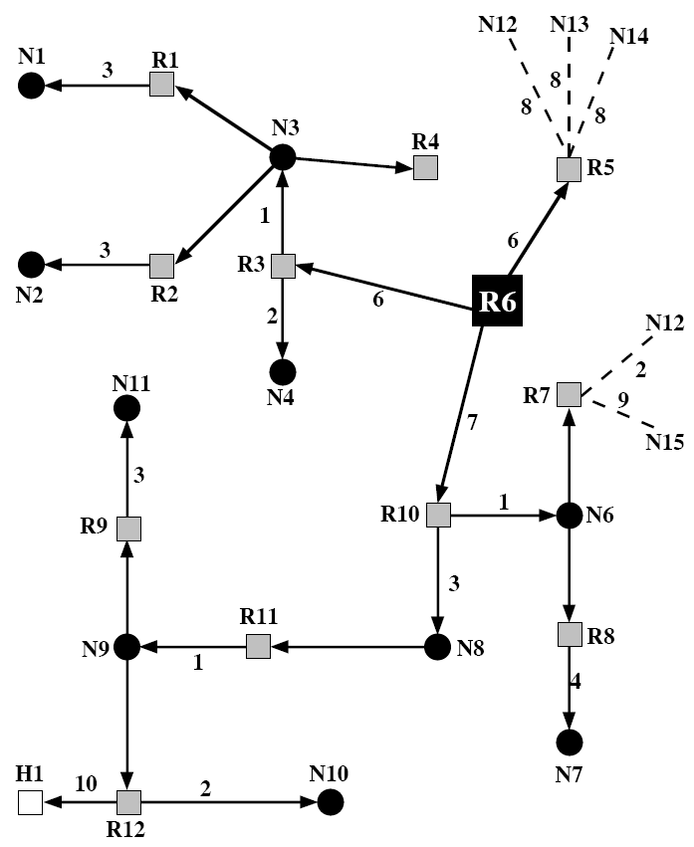
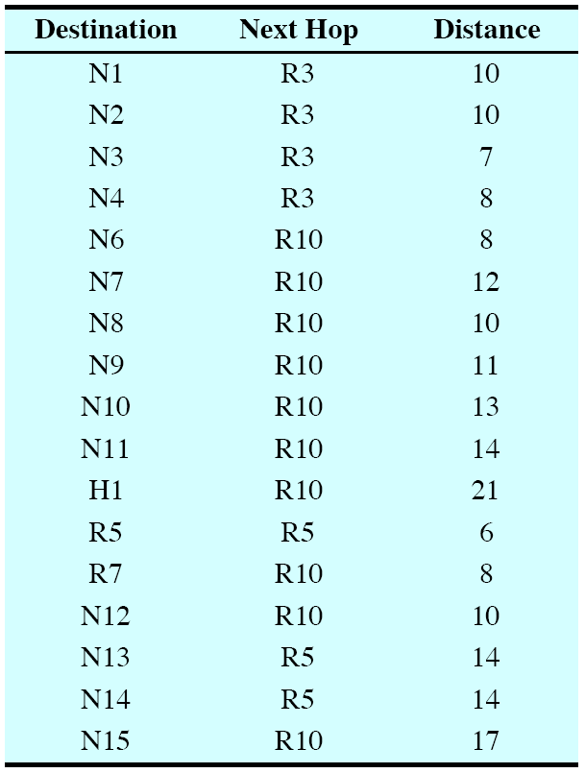
OSPF– Router 6’s view

Slide 19
Routing Information Protocol (RIP)
More in IS 1071
General
Interior protocol
“Distance vector” protocol: minimize distance to the destination
Algorithm does the following
Share its knowledge about the AS with its neighbors
Shares only with its neighbors
Shares at regular intervals
Computes shortest distance based on its knowledge of the network

Slide 20
Finding a Host on a Subnet
Hosts are known to a subnet (eg. LAN) by their local attachment address (eg. Ethernet or MAC address)
An IP address does not help deliver a packet - it is encaspulated in MAC layer frame
Solution: Make a table associating IP with network attachment MAC addresses and timeout
How?
Broadcast unknown IP addresses to all hosts on a subnet
Wait for a host to respond
Address Resolution Protocol (ARP)

Slide 21
ARP
802.3 and 11 MAC address allocation administered by IEEE
Manufacturer buys portion of MAC address space (to assure uniqueness)
Analogy:
(a) MAC address: like Social Security Number
(b) IP address: like postal address
MAC flat address ➜ portability
can move LAN card from one LAN to another
IP hierarchical address NOT portable
Depends on IP subnet to which node is attached

Slide 22
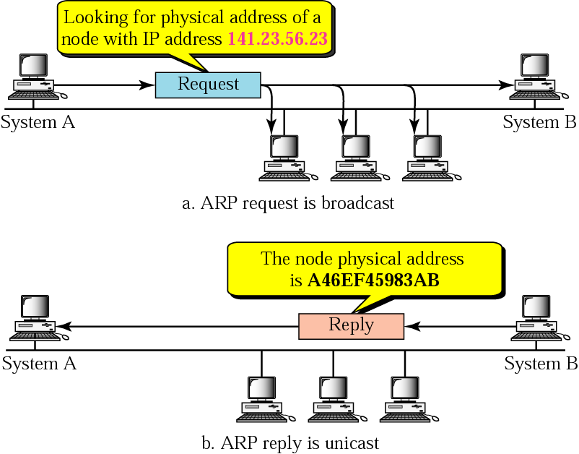
Address Resolution Protocol
ARP can be considered to be at or slightly above “Layer 2”
Implemented in OS

Slide 23
ARP protocol: Same LAN (network)
A wants to send datagram to B, and B’s MAC address not in A’s ARP table.
A broadcasts ARP query packet, containing B's IP address
Dest MAC address = FF-FF-FF-FF-FF-FF
all machines on LAN receive ARP query
B receives ARP packet, replies to A with its (B's) MAC address
frame sent to A’s MAC address (unicast)
A caches (saves) IP-to-MAC address pair in its ARP table until information becomes old (times out)
soft state: information that times out (goes away) unless refreshed
ARP is “plug-and-play”:
nodes create their ARP tables without intervention from net administrator

Slide 24
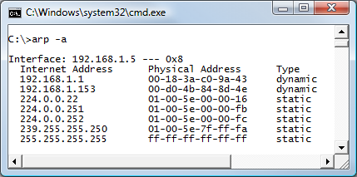
ARP data
Resolved MAC addresses are saved in cache for some time
Can be retrieved using arp -a

Slide 25
ping Command
ping command: testing basic network connectivity
Ping (Packet Internet Groper) uses the Internet Control Message Protocol (ICMP), sending a message called an ICMP echo request to another IP address.
The computer with that IP address should reply with an ICMP echo reply.

Slide 26
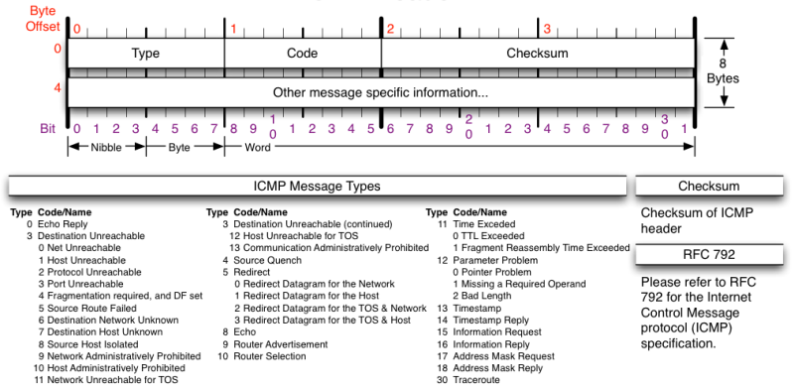
ICMP
ICMP defines many messages that devices can use to help manage and control the IP network.

